Slide 1
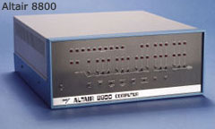
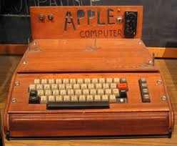
Technological Wonders
Expanded use of the air-conditioning:
Allowed for more tolerable working conditions in building
Encouraged urban development
Stimulated economic growth in hot and humid climates (SE & SW).
Personal computers & the Internet
Gave consumers the possibilities of the future
Eventually allowed people to connect all over the world
Today, we have computers in our pockets - Cellphones
Altair 8800 - 1975
Apple I - 1976

Slide 2
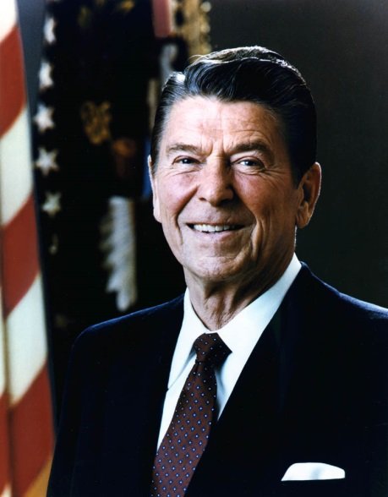
The Ronald Reagan’s Presidency
Republican Ronald Reagan was elected the 44th President in 1980.
His 1st priority - Fix the nation’s economy.
Reaganomics AKA trickle down economy
-Passed a 25% tax cut
-Deregulated government control
-Cut some social programs
-Regulate the money supply
By 1983, the U.S. economy was in full recovery

Slide 3
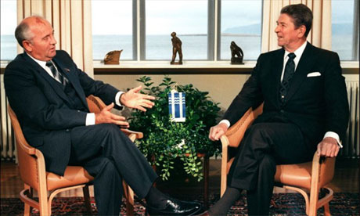
Collapse of the Soviet Union
Reagan & Russian leader Gorbachev met several times in ‘87 agreeing to remove some nuclear weapons from Europe.
This led Gorbachev to reduce Soviet spending on defense and aid to other communist controlled countries in Europe.
In 1989, several former Soviet controlled countries were allowed to form non-communist governments.
Trying to save their Communist ways, Communist leaders and some Russian Army officers tried to overthrow Gorbachev.
Their coup was unsuccessful, and in December 1991, Gorbachev announced the end of the Soviet Union.

Slide 4
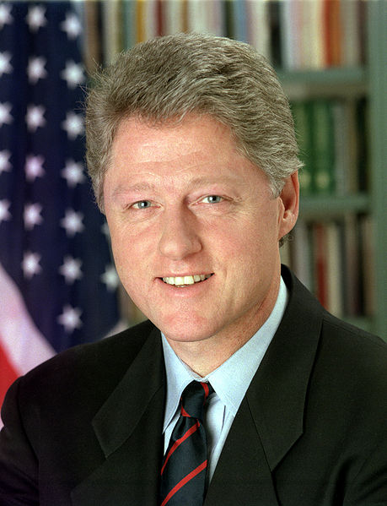
President Clinton
42nd POTUS
Governor of Arkansas
Rhodes scholar
Democratic President Clinton had a mixed relationship with the Republican Congress.
Signed NAFTA- opened free trade and dropped trade barriers between the U.S., Canada, and Mexico. However, it also sent a lot of jobs to Mexico.

Slide 5
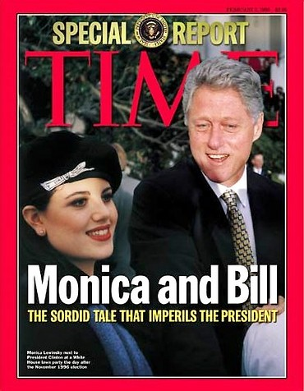
The Impeachment of President Clinton
In January 1998 Clinton was linked to an improper relationship with a White House intern.
Initially, Clinton denied a relationship existed but eventually acknowledge it.
The House impeached Clinton on perjury & obstruction of justice.
the Senate acquitted Clinton of the charges.
Clinton became only the second President to face Impeachment.

Slide 6
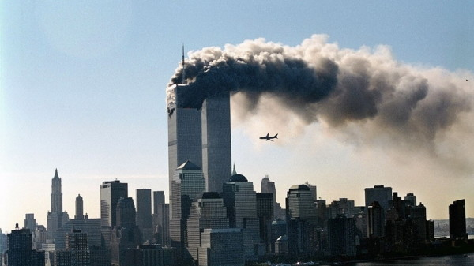
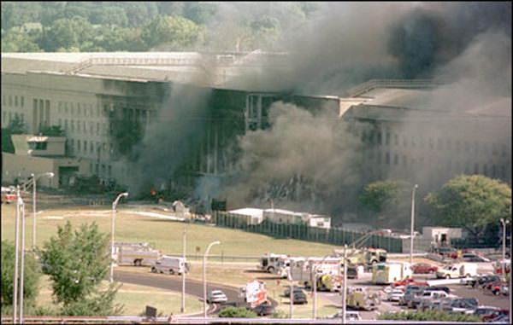
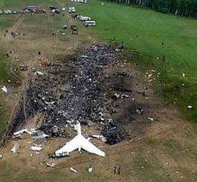
The 9/11 Attacks
On September 11, 2001, hijackers took over four jetliners
crashing two into the World Trade Center Towers
one into the Pentagon
one into a field in Pennsylvania after passengers tried to take back control of the plane (possible intended target: White House, U.S. Capital, Camp David or Nuclear Power Plants along the Eastern seaboard)
"Let's Roll" (5.30)

Slide 7
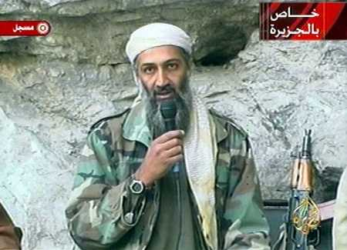
The War on Terrorism
The attacks were quickly linked to a terrorist named Osama bin Laden and his group al Qaeda.
President Bush ordered an invasion of Afghanistan, where bin Laden kept his headquarters. This was part of Bush’s larger war on terrorism, for which he built an international coalition to fight the al-Qaeda network and other terrorist groups.
Bin Laden was killed in 2011, under the orders of President Obama, by the U.S. Navy Seals in a compound in Pakistan

Slide 8
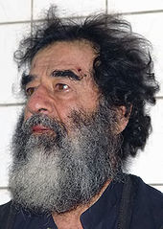
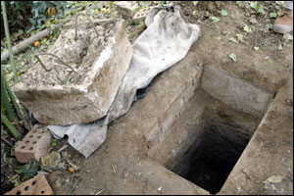
Iraq
In March 2003, American and British troops invaded Iraq in Operation Iraqi Freedom.
Iraq’s president, Saddam Hussein, went into hiding while U.S. forces searched for the weapons of mass destruction (WMD) that Bush feared Hussein had and could supply to terrorists for use against the United States.
No WMD were found.
Hussein was captured in December 2003.
He was convicted of crimes against humanity and executed in 2006.

Slide 9
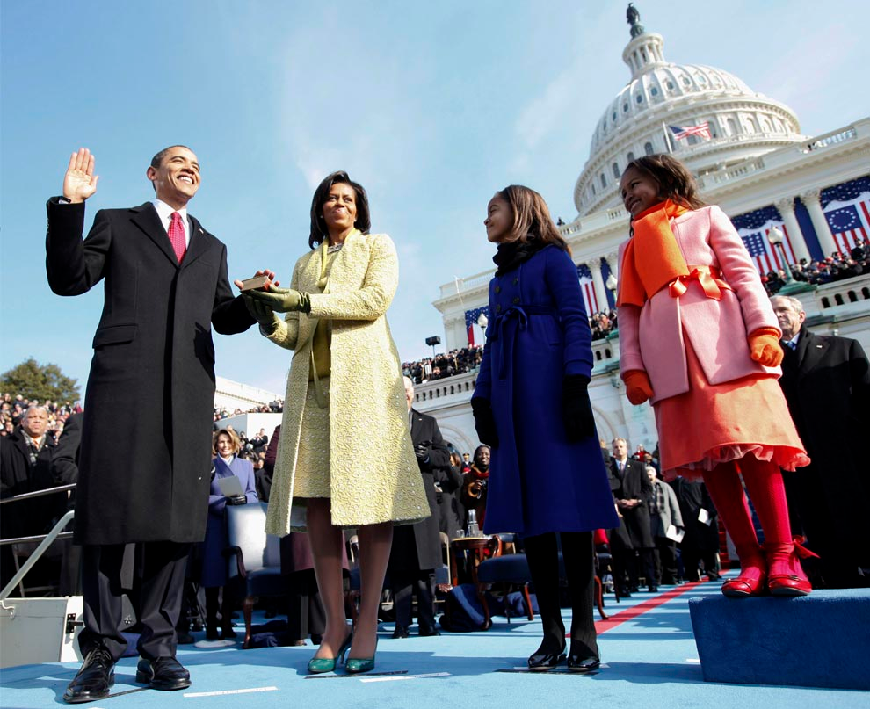
The Election of President Obama
On November 4, 2008, Barack Hussein Obama II defeated John McCain to become the 44th president of the U.S.
2012, President Obama became a two term president by defeating Mitt Romney
Major Accomplishments include:
Ended the Great Recession (2008) – Economic stimulus package / bailed out the U.S. Auto industry
Received to Nobel Peace Prize in 2009
Reformed healthcare - ACA 2010
Eliminated Public Enemy # 1 - Osama bin Laden in 2011
CNN coverage of 2008 Election
The Election of President Obama
Notes:
In1619 the first Africans slaves were brought to America; 1865 the 13th Amendment passed – 143 yrs. From 2008 we had slavery

