Slide 1
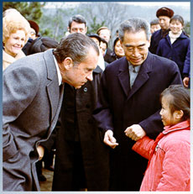
President Richard Nixon & China
Nixon wanted to create a peaceful world by building a better relationship with China and Russia.
He lifted trade and travel restrictions with China.
Nixon traveled to China in 1972, becoming the first President to visit the country.
Nixon hoped that the visit to China would
force Russia to open peaceful talks with the U.S.

Slide 2
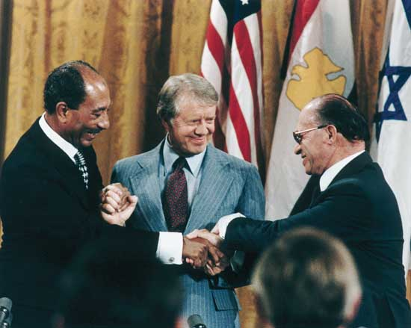
Camp David Accords
In 1978 President Carter helped to broker a peace agreement between Israel and Egypt, two Middle Eastern countries which had been bitter enemies.
Israel is a Jewish country, Egypt is an Arab nation.
The peace treaty was known as the Camp David Accords.

Slide 3
The Carter Administration and Iran
Iran was supported by the U.S. – oil & buffer against Russian expansion.
The Shah of Iran had become unpopular due to him westernizing Iran.
In 1979, Islamic extremist, forced the Shah to flee the country. The Shah, who was ill, was allowed to receive medical treatment in the U.S.
In response, revolutionaries, stormed the U.S. embassy and took 52 Americans hostage.
The hostages were finally released on Carter’s last day in office after being held for 444 days.

Slide 4
War Powers Act of 1973
A federal law intended to check the U.S. president's power to commit the United States to an armed conflict without the consent of the U.S. Congress.
Established to counter the power that was given to LBJ with the Gulf of Tonkin Resolution.
Laymen Terms: Put the power to declare war back in the hands of congress
The new law required the following:
The president to notify Congress within 48 hours of committing armed forces to military action
The President can only send troop for 30 days
The President has an additional 30 days to withdrawal the troops if congress doesn’t give authorization or declare war.
This gives the president a total of 60 days to commit troops unless Congress gives approval

