Slide 1
Rachel Carson’s Silent Spring
Silent Spring, a 1962 book about pesticides by Rachel Carson, exposed dangers to the environment.
This book led to the water quality act of 1965
The first Earth Day was celebrated in 1970, this raised awareness of environmental issues.
In 1970, Pres. Nixon created the Environmental Protection Agency (EPA) to set limits on pollution.

Slide 2
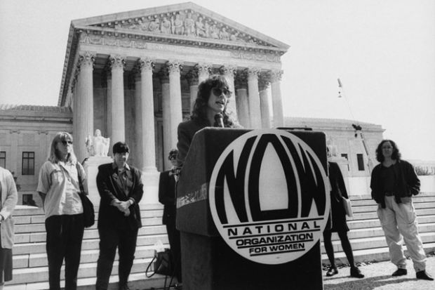
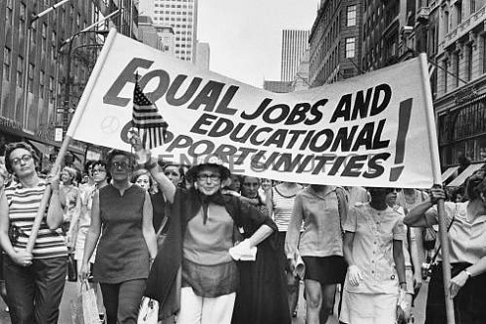
The National Organization of Women
The National Organization of Women (NOW) was founded in 1966 to promote equal rights and opportunities for American women.
NOW had its origins in the Civil Rights & anti-war Movements of the early 1960s.
NOW’s goals included equality in employment, political and social equality, and the passage of the Equal Rights Amendment.

Slide 3
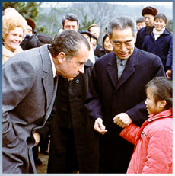
President Richard Nixon & China
Nixon wanted to create a peaceful world by building a better relationship with China and Russia.
He lifted trade and travel restrictions with China.
Nixon traveled to China in 1972, becoming the first President to visit the country.
Nixon hoped that the visit to China would
force Russia to open peaceful talks with the U.S.

Slide 4
Watergate
In 1972 President Nixon began his reelection campaign.
Fearing that various political issues might cause him to lose, some of Nixon’s campaign staff began spying on his opponent.
In June 1972, five men linked to Nixon’s campaign, were arrested breaking into the Democratic Party’s headquarters in the Watergate Hotel.
The President denied any wrong doing and eventually won reelection.
By June of 1973 it was revealed that Nixon had some involvement and resigned in 1974 to avoid impeachment.
His VP Ford became President and pardoned Nixon.
DNC Headquarters @ Watergate complex
Notes:
Pardoned - to allow (a wrong act) to pass without punishment; to forgive.

Slide 5
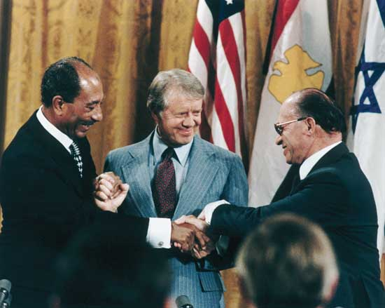
Camp David Accords
In 1978 President Carter helped to broker a peace agreement between Israel and Egypt, two Middle Eastern countries which had been bitter enemies.
Israel is a Jewish country, Egypt is an Arab nation.
The peace treaty was known as the Camp David Accords.

Slide 6
The Carter Administration and Iran
Iran was supported by the U.S. – oil & buffer against Russian expansion.
The Shah of Iran had become unpopular due to him westernizing Iran.
In 1979, Islamic extremist, forced the Shah to flee the country. The Shah, who was ill, was allowed to receive medical treatment in the U.S.
In response, revolutionaries, stormed the U.S. embassy and took 52 Americans hostage.
The hostages were finally released on Carter’s last day in office after being held for 444 days.

